Slide 1

Compiler Design Sohrab Namazinia
97522085
Spring 2021

Slide 2
Assignment Specifications
Subject: Introduction to Listener
Deadline: Monday, 25 Esfand, 23:59 (Would not be extended!!)
Where to upload: LMS
Your report should be provided continuing these slides
Full Name: Sohrab Namazinia
Student ID: 97522085

Slide 3
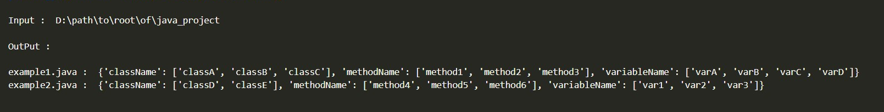
Assignment Details
Write a Python program using Listener to extract these from a Java project:
The names of all classes exist in each Java file.
The names of all methods exist in each Java file.
The names of all variables exist in each Java file
As sth like below:
Note: The output format can be different depends on your Java project. You might have different number of java files, classes, methods & variables.

Slide 4
Assignment Details (Continued)
2. Write a report of what you did .Test some examples on & use images to make your report more clear.
Good Luck!

Slide 5
Introduction
I have uploaded this documentation with my python project that consists all the code to do the second assignment.
In the next slide, I will explain the steps that I took to do the assignment. For testing a project you just need to set the project path in Path.py, then run main file.
First of all, I just created a project in pycharm, my project has the following packages\files that I will explain their details in next slides:
Gen
Grammar
Test_project
Utils
Main.py

Slide 6
Configure Antlr
I installed antlr4 for python3 runtime.
I created grammar folder and put the 3 grammar files in that folder. It was said in TA class that “JavaParserLabled.g4” is what we should use instead of “JavaParser.g4”.
Then I configured antlr for lexer\ParserLabled grammar files and generated the corresponding antlr files in gen folder.
Also I copied the TA class test project in my project for testing purposes.

Slide 7
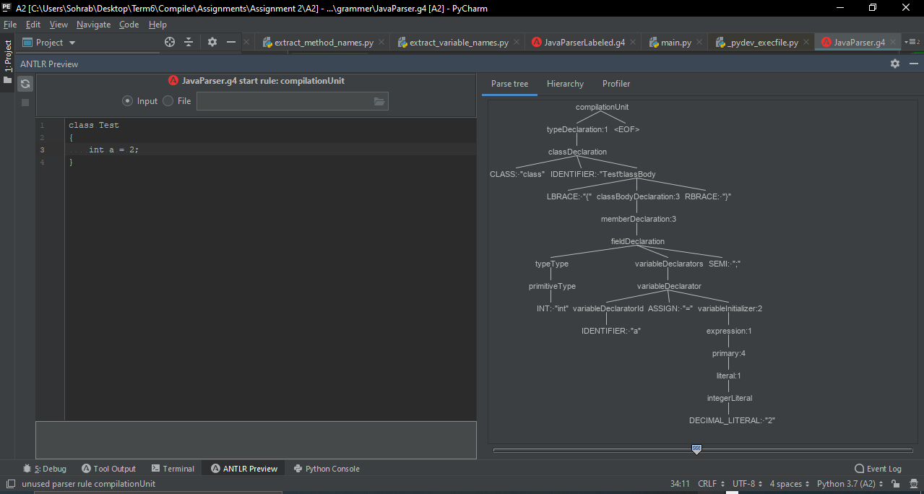
Configure Antlr

Slide 8
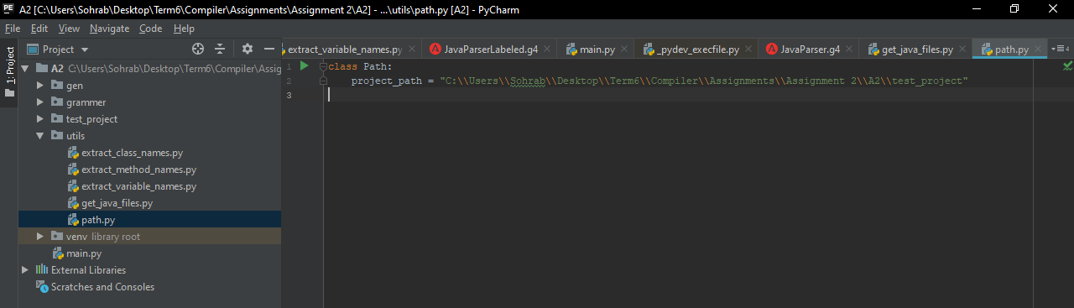
Path.py
Then I created a Path.py python file. which only has one variable “project_Path”. This variable is used in all the project as the project path that we want to test. Now with this approach you can edit this variable to test other projects.

Slide 9
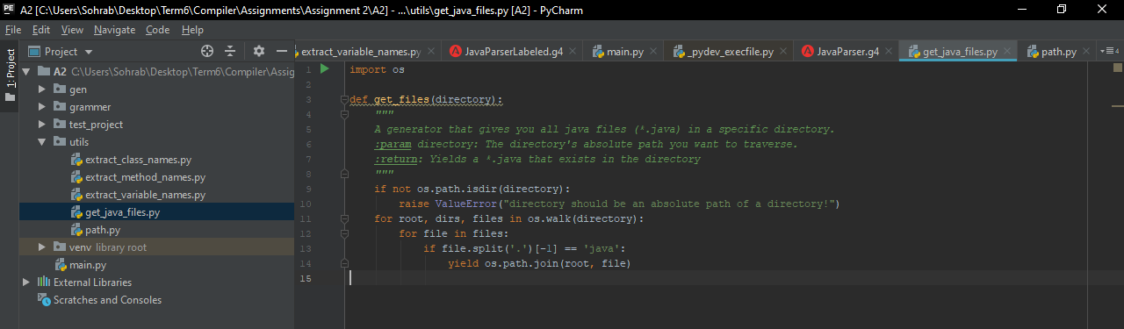
Get java files
Then I created a file (got help from TA Class)for doing tasks that are related to finding files, etc. in this class I just wrote a method “get_files” that takes a directory and returns all the java files in that project.

Slide 10
Extract (class, variable, method) names
Now time to write the core code. I created 3 separate files for each of our 3 purposes in this project:
Extract_class_names.py
Extract_variable_names.py
Extract_method_names.py
All these files have exactly the same structure. Each file has used __name__ attribute that is used when I want to run each file separately one by one for testing. Also there are some “imports” in each files. But they have one important class called “ClassNameListener” (“MethodNameListener”, “VariableNameListener”). This class derives from our JavaParserLabledListener.

Slide 11
Extract (class, variable, method) names
In that I have implemented 2 of its method that are entering and exiting the required node. For example in method file, it is “enterMethodDeclaration” and “exitMethodDeclaration”. In each I have commented some “print” statements that are mostly used for testing or running the files separately. For our main purpose, the results will we stored in the class variable “method_names” (“class_names” and “variable_names”). Then you can get the result by that variable. So what I do is to append the node name in the implemented method (enter node) to the class field. Foe example in extract_method_names, we will create an object that will traverse the parse tree and every time it enters a methodeclaration, it appends the name of it’s identifier to the field called method_names. Finally we can get the result by that.

Slide 12
Extract (class, variable, method) names
Also I wrote a run method which does its tasks over ALL the java files in the project. It is not used in my assignment because for every file, we must get all the details one by one. but that’s a good practice. What it does is similar to the other (static) method that I wrote in each class called run_file(file_path). This method just does it’s job on a particular java file. we will use that in our main method to get the result. So there are 3 run_file(file_path), one for each class, method, and variable listeners. What it does is it created the fileStream, pass it to lexer, create the tokens, pass it to parser, construct the tree, create listener object from our written class, create walker object, finally walk the parse tree with our listener and tree. After this, our class fields (for example variable_names) are set correctly for that java file that we pass to it as argument. So we just finally return that as result. Same thing happens for each of our three listeners.

Slide 13
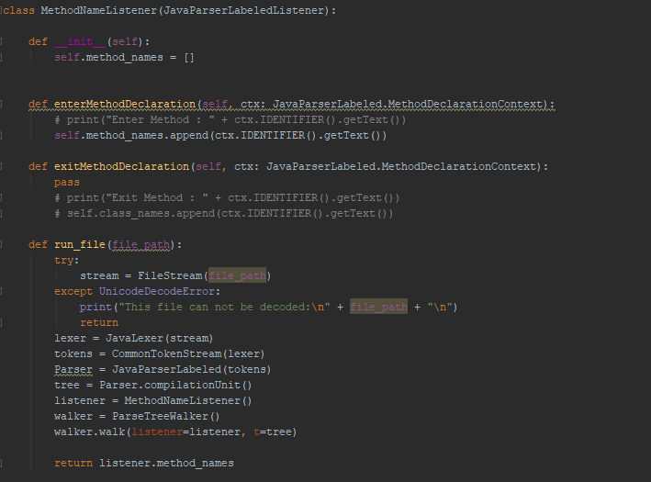
Extract (class, variable, method) names

Slide 14
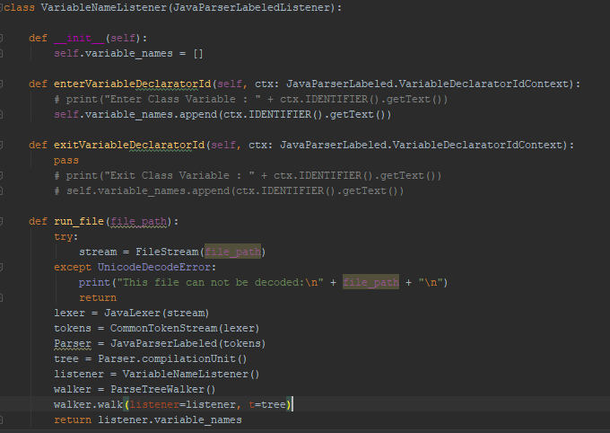
Extract (class, variable, method) names

Slide 15
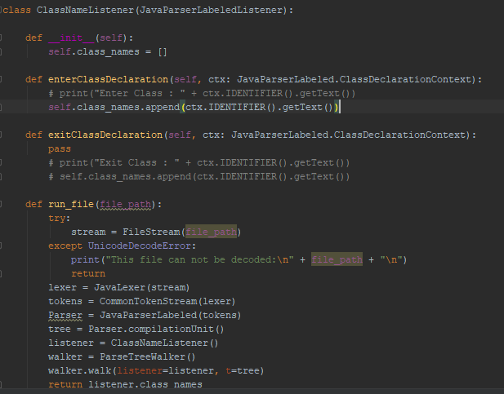
Extract (class, variable, method) names

Slide 16
Main.py
Now just we need to use our code to get the result.
First I have get all the java files of the project by my method. Then I have iterated on the java files and do what I should have done.
For each file, first I have printed its name. then I have used ClassNameListener run_file method to get the class names of that files, then print them. after that, same thing happens for MethodNamelistener and VariableNameListener. After these steps, I have printed some asterisks so that it becomes clear in the output console that the job of this file has been finished.
Then, same thing is done for the next file and so one.

Slide 17
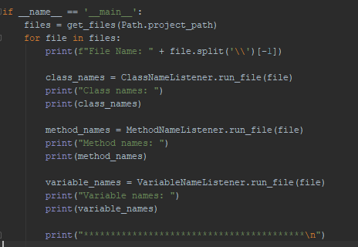
Main.py

Slide 18
Output
Since the output in the console was very large, I couldn’t paste all here, but I just took a shot from a part of that and put it in the next slide. But you can see the complete output simply by running the main file.

Slide 19
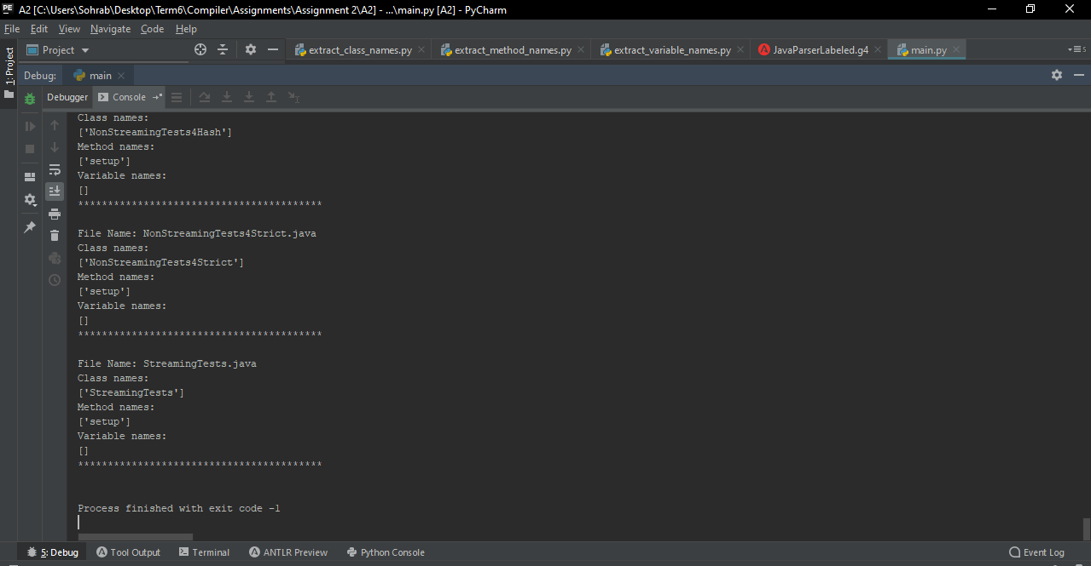

Slide 20
Thanks

